Slide 1
Software Testing and Quality Assurance
Theory and Practice
Chapter 9
Functional Testing
Notes:
Handouts
------------------------------------------------------------------
------------------------------------------------------------------
-------------------------------------------------------------------
--------------------------------------------------------------------

Slide 2
Outline of the Chapter
Equivalence Class Partitioning
Guidelines for Equivalence Class Partitioning
Identification of Test Cases
Advantages of Equivalence Class Partitioning
Boundary Value Analysis (BVA)
Guidelines for Boundary Value Analysis
Notes:
Handouts

Slide 3
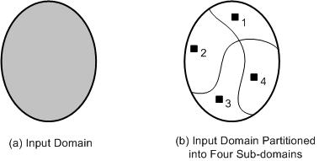
Equivalence Class Partitioning
An input domain may be too large for all its elements to be used as test input (Figure 9.8(a))
The input domain is partitioned into a finite number of subdomains
Each subdomain is known as an equivalence class, and it serves as a source of at least one test input (Figure 9.8(b))
A valid input to a system is an element of the input domain that is expected to return a non error value
An invalid input is an input that is expected to return an error value.
Figure 9.8: (a) Too many test input; (b) One input is selected from each of the subdomain
Notes:
Handouts

Slide 4
Guidelines for Equivalence Class Partitioning
An input condition specifies a range [a, b]
  one equivalence class for a < X < b, and
  two other classes for X < a and X > b to test the system with invalid inputs
An input condition specifies a set of values
  one equivalence class for each element of the set {M₁}, {M₂}, ...., {M_{N}}, and
  one equivalence class for elements outside the set {M₁,M₂, ...,M_{N}}
Input condition specifies for each individual value
  If the system handles each valid input differently then create one equivalence class for each valid input
An input condition specifies the number of valid values (Say N)
  Create one equivalence class for the correct number of inputs
  two equivalence classes for invalid inputs – one for zero values and one for more than N values
An input condition specifies a “must be” value
  Create one equivalence class for a “must be” value, and
  one equivalence class for something that is not a “must be” value
Notes:
Handouts

Slide 5
Identification of Test Cases
Test cases for each equivalence class can be identified by:
Assign a unique number to each equivalence class
For each equivalence class with valid input that has not been covered by test cases yet, write a new test case covering as many uncovered equivalence classes as possible
For each equivalence class with invalid input that has not been covered by test cases, write a new test case that covers one and only one of the uncovered equivalence classes
Notes:
Handouts

Slide 6
Advantages of Equivalence Class Partitioning
A small number of test cases are needed to adequately cover a large input domain
One gets a better idea about the input domain being covered with the selected test cases
The probability of uncovering defects with the selected test cases based on equivalence class partitioning is higher than that with a randomly chosen test suite of the same size
The equivalence class partitioning approach is not restricted to input conditions alone – the technique may also be used for output domains
Notes:
Handouts

Slide 7
Example
Example: Adjusted Gross Income. Consider a software system that computes income tax based on adjusted gross income (AGI) according to the following rules:
If AGI is between $1 and $29,500, the tax due is 22% of AGI.
If AGI is between $29,501 and $58,500, the tax due is 27% of AGI.
If AGI is between $58,501 and $100 billion, the tax due is 36% of AGI.

Slide 8
Example
1. $1 ≤ AGI ≤ $29,500.
2. $29,501 ≤ AGI ≤ $58,500.
3. $58,501 ≤ AGI ≤ $100 billion.
First we consider condition 1, namely, $1 ≤ AGI ≤ $29,500, to derive two ECs:
EC1: $1 ≤ AGI ≤ $29,500; valid input.
EC2: AGI < 1; invalid input.
Then, we consider condition 2, namely, $29,501 ≤ AGI ≤ $58,500, to derive one EC:
EC3: $29,501 ≤ AGI ≤ $58,500; valid input.

Slide 9
Finally, we consider condition 3, namely, $58,501 ≤ AGI ≤ $100 billion, to derive two ECs:
EC4: $58,501 ≤ AGI ≤ $100 billion; valid input.
EC5: AGI > $100 billion; invalid input.
Note that each condition was considered separately in the derivation of ECs.
Conditions are not combined to select ECs. Five test cases are generated to cover the five ECs,

Slide 10
Boundary Value Analysis (BVA)
The central idea in Boundary Value Analysis (BVA) is to select test data near the boundary of a data domain so that data both within and outside an equivalence class are selected
The BVA technique is an extension and refinement of the equivalence class partitioning technique
In the BVA technique, the boundary conditions for each of the equivalence class are analyzed in order generate test cases
Notes:
Handouts

Slide 11
Guidelines for Boundary Value Analysis
The equivalence class specifies a range
  If an equivalence class specifies a range of values, then construct test cases by considering the boundary points of the range and points just beyond the boundaries of the range
The equivalence class specifies a number of values
  If an equivalence class specifies a number of values, then construct test cases for the minimum and the maximum value of the number
  In addition, select a value smaller than the minimum and a value larger than the maximum value.
The equivalence class specifies an ordered set
  If the equivalence class specifies an ordered set, such as a linear list, table, or a sequential file, then focus attention on the first and last elements of the set.
Notes:
Handouts

Slide 12
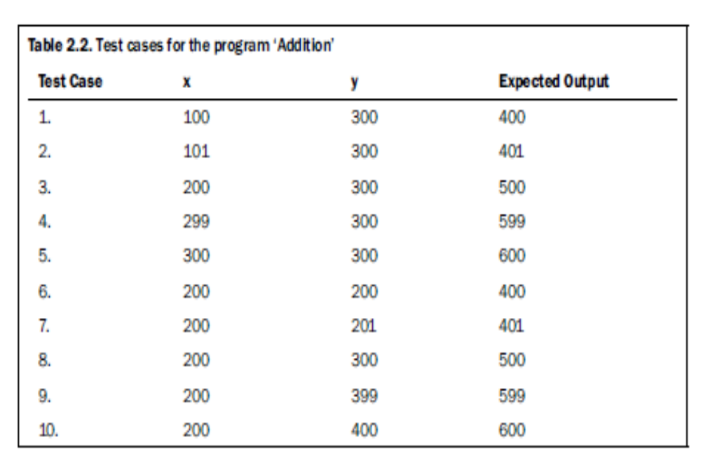
Example

Slide 13
